Slide 1
THE CONNECTION PROJECT
Raising Kids and Finding Balance in a Digitally Connected World
Emily Cherkin, The Hallowell-Todaro Center
Bryant Elementary School
Monday, December 12, 2016

Slide 2
ABOUT ME
Notes:
BEMS
SAAS, HTC: Coach, run parent workshops
Tonight I am giving you a small portion of my workshops– if you find this interesting, I offer more comprehensive coaching for families or kids or my workshops

Slide 3
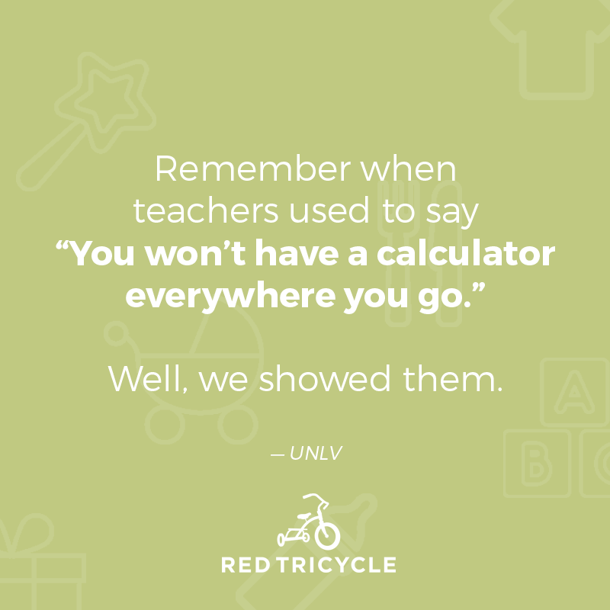

Slide 4
When I was a kid, “technology” meant….

Slide 5
For my children, “technology” means….

Slide 6
Notes:
Hallowell: Frog in boiling water.
Parents of daughters in middle school vs. high school

Slide 7
Replace judgment with curiosity.
Notes:
Remember that we are all here because we care about our kids and we can all be really hard on ourselves. We won’t solve problems by beating up on ourselves– we have to look for solutions.
It’s not a one-size fits all.
Different strategies work for different families.
We will make mistakes.

Slide 8
QUESTIONS TO THINK ABOUT:
What devices do your kids have access to?
What rules does your family have around technology use?
How are these rules enforced?
Notes:
Going to give you some stats. Don’t panic. Use this to know where we are coming from.

Slide 9
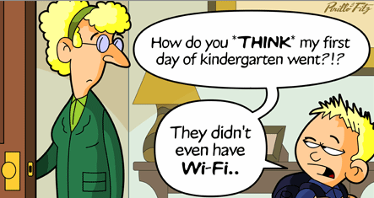
Notes:
First thing my son learned in kindergarten here at Bryant was CONTROL ALT DELETE and underscore to log in.

Slide 10
For 2-5 YEAR OLDS…
More can play a computer game than can ride a bike.
Almost 20% can use a Smartphone application; only 9% can tie their shoes.
More young children can open a web browser than can swim.
Source: AVG, Internet Security Company, 2014

Slide 11
For 8- TO 18-YEAR-OLDS*
Consume over 7 hours of screen media per day (a 2.5 hour increase in 10 years)
Screen time can be habit-forming.
Screen time is linked to sleep disturbance.
Source: Campaign for a Commercial Free Childhood
Notes:
And we know “multitasking” is not real: research shows us that when we are attempting to multitask, we THINK we are being more productive, when in fact we are actually being LESS so.
Excessive screen time is linked to increased psychological difficulties such as hyperactivity, emotional and conduct problems, difficulties with peers, and poor school performance.
http://www.commercialfreechildhood.org/sites/default/files/kidsandscreens_0.pdf

Slide 12
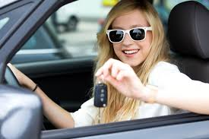
Notes:
How many of you have a kid of driving age?
How many of you learned to drive at age 16?
What happened– did you have to take driver’s ed? Did someone practice with you? Did you have to pass a test? Drive with adults?
Same logic should apply for smartphones: they are not phones, they are computers. We wouldn’t hand our 16 year old the car keys; we shouldn’t hand them a smart phone without information, rules, expectations etc.
Similarly, do we want our kids seeing US texting while driving?
This is a topic I explore much further in my workshops.

Slide 13
25,000 ads
$17 billion
Source: Campaign for a Commercial-Free Childhood
Notes:
No question thinking about teens texting and driving is scary. However, for the elementary age group in particular, marketing to children is another HUGE concern, and one parents should be aware of.
According to one estimate, the average American child will see over 25,000 ads per year on TV alone. Over $17 billion is spent per year by companies advertising to children in the United States.
*This number EXCLUDES product placement, ads on Internet, cell phones, mp3 players, video games, school buses, and at school.
*This $17 billion is a staggering increase from 1983, when “merely” $100 MILLION was spent.

Slide 14
According to the American Psychological Association (APA), children under the age of 8 are unable to critically comprehend televised advertising messages and are prone to accept advertiser messages as truthful, accurate, and unbiased.
Notes:
Sweden, since 1991, has banned all ads during kid’s prime time due to findings that kids under 10 are incapable of telling the difference between a commercial and a program and cannot understand the purpose of a commercial until the age of 12.
Other concerns: food advertising (for junk food) is directly contributing to obesity epidemic in country
From: children as consumers artcile
EG: Sylvie in the cereal aisle: Kung Fu panda vs. dragon on tea box

Slide 15
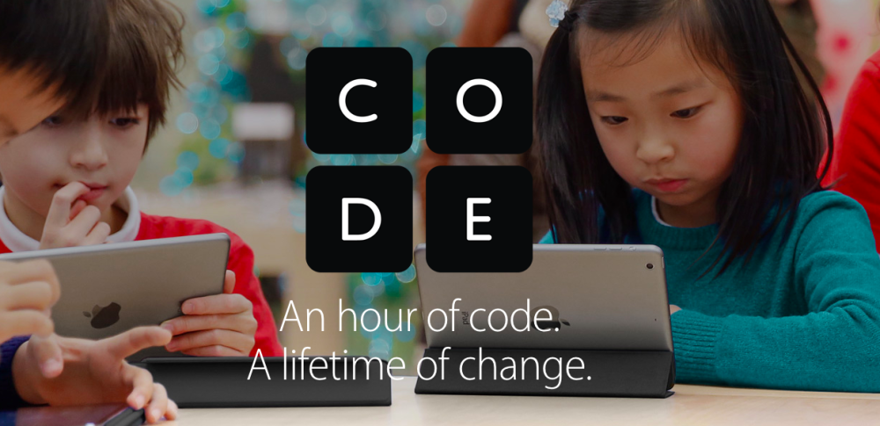
THE VALUE OF TECHNOLOGY
Notes:
3-D printing, sequencing genomes, connect with virtually anyone around world, Facebook balloons/drones with internet access (close digital divide), DV victims in India using Snapchat to report, the Arab Spring (twitter), natural disasters (FB “I’m safe”), being able to access almost anything in seconds (or less), crowdsourcing/funding/giving, people with disabilities, brain injury treatment, scientific progress, using games like Minecraft to use coding and logic, teens reporting self-injuring/suicidal friends, decreasing feeling “awkward” in social situations, digital creativity-- art, music, books, graphics, nephew with diabetes whose parents can monitor from work via iPhone

Slide 16
Social skills
Executive Function skills
Dopamine
Instant Gratification
Notes:
Paradox: parents think giving kids screens is HELPING by increasing kids’ “ability to focus, concentrate, lend attention, sense other people’s feelings, build large vocabulary”. However, these are actually the very developmental skills that are impeded by tablets and smartphones.
Screens impact the brain in the following categories (there are other ways, but these are big ones):
1. Social skill development: when kids use screens, they are less able to read facial cues, nonverbal communication when interacting with humans. This is critical in early development. Brains Frontal Lobe is the part used to decode/understand social interactions Similarly, frontal lobe is where we develop empathy. Too much screen time and not enough face-to-face interaction means dulling of empathetic abilities. Decrease in empathy- CAN BE BUILT BACK. Kids are resilient.
EF skills are critical for everyone, and are most affected in people with ADHD. Screens TAKE AWAY opportunities to develop many of these skills (though some programs can enhance/teach them– it’s complicated). For kids with ADHD, they are particularly prone to screen abuse/addiction. Think of our own struggles with screen addiction– it’s even harder for kids…
Which leads to third point: dopamine, the “pleasure” hormone released in the brain when we do something that feels “good”. Dr. Delaney Rusten, of Screenagers film, notes that MRIs of the brains of kids playing video games 20 hours or more per week are similar to the brains of alcohol and drug addicts. This is worrisome, particularly for kids with ADHD. Centers like ReSTart in Gold Bar are indicative of a culture where for some, screen addiction and abuse is as real as drug/gambling/shopping addiction.
This one is interesting from a cultural standpoint: what does Instant Gratification mean to our kids vs our own generation raised hearing about the “marshmallow” study? Think about Amazon- -our kids– and US– expect that things will be here within 24 hours– or less. Children start to internalize that “all actions have an immediate effect” and “all stimuli elicit a quick response” : this triggers dopamine response, which can feel addictive. Kids start to prefer this immediate gratification over real-world connections (psych today)

Slide 17
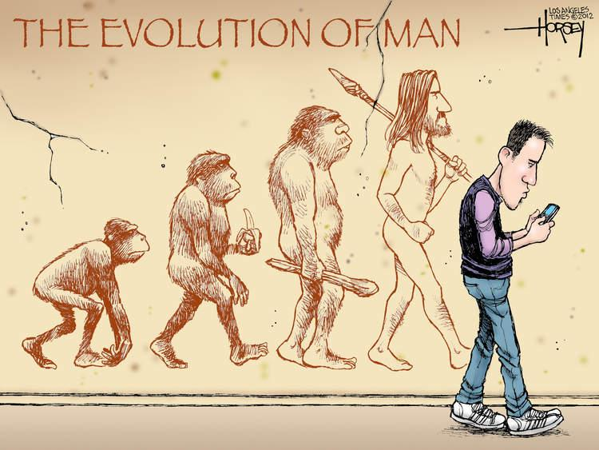

Slide 18
IT’S NOT JUST THE KIDS…
Notes:
What do your kids see you doing with screens?
How do they know the difference between work and entertainment and social uses? (How do you?)
How to you talk to your family about screens?
Do you have a “tech-positive” parenting approach?
Do you set rules for your kids that you don’t follow?
http://www.latimes.com/local/education/la-fi-parent-screen-time-study-20161206-htmlstory.html
Most recent research (Dec. 6 2016):
-Parents spending upwards of NINE hours a day connected to screen-based media (and only 90 minutes of that is for work; the rest is for “personal screen media”)
-78% of parents believe they are “good media and technology role models”
-Jim Speyer, CEO of common sense media; “...We have to model behavior. And kids won’t change unless we change.”
“Monitoring cannot substitute for mentoring”- devorah heitner “Screenwise”

Slide 19
Notes:
I asked my 5 y o “What rules should Mommy and Daddy follow?” after she pointed out that we were “breaking” our agreement.
This is what she said…
From the mouths of babes...

Slide 20
“Texting is giving someone who isn’t even in the room permission to interrupt you.”
-Ben (my husband)

Slide 21
THE PULL OF SCREENS AND TECH
FOMO
“Looping”
Endless feeds
Constant state of “insufficiency”
Triggers dopamine in the brain
Sense of “urgency”
Notes:
Teens especially prone to addictive behaviors because of what’s happening in their brain changes– much higher risk taking behavior. Hormones make all the feelings MORE intense (pleasurable, bad, good, scary)
But also important to ask ourselves, how many of us experience these feeling as well?
Addiction is real, but not super common…we used to joke about the “crackberry”. Now there are real places where you can go for tech detox (ReStart in Gold Bar)
How do we know when it is addiction? (true with other addictive substances/behaviors)
When our relationships and/or work suffer
When we are unable to live without
Same part of the brain is affected as in addiction to drugs, alcohol, porn, gambling, shopping, etc.
http://www.washingtonpost.com/sf/style/2016/12/07/video-games-are-more-addictive-than-ever-this-is-what-happens-when-kids-cant-turn-them-off/
“Researchers are still trying to figure out exactly how and why video games affect the brain. One 1998 study showed that video games raise the level of dopamine in the brain by about 100 percent, roughly the same increase triggered by sex. (And that was nearly 20 years ago — today’s games have evolved far beyond what was available then.)”

Slide 22
“We shape our tools, and afterwards, our tools shape us.”
Marshall McLuhan
Notes:
How do you want your tools to shape YOU and your family??

Slide 23
SHAPE YOUR TOOLS
Clear limits.
Model.
Engage.
Balance.
Notes:
65% of parents do NOT set limits. As Sylvie says, GET SCREENS OUT OF BEDROOMS.
How much are WE on screens? How much are WE influenced by media?
Engage: talk about it, avoid judging, ask questions, learn kid culture
Not all tech/screens/media is bad: help kids figure out what is good, what isn’t and why.

Slide 24
THE CONNECTION PROJECT WORKSHOP
WHEN: (4-week sessions, two options):
Tuesdays (Jan 24, Jan 31, Feb 7, Feb 14) 9:30-11 AM
Thursdays (Jan 26, Feb 1, Feb 9, Feb 16) 7:00-8:30 PM
TOPICS:
”Digital Natives vs. Digital Immigrants”
“Finding Balance in Family Screen Use”
“When Behaviors Shape Our Brains”
”Creating a ‘Tech-Positive’ Family Environment”
WHERE:
The Hallowell-Todaro Center (5502 34th Ave NE)
HOW:
To register, email emily@hallowelltodarocenter.org or
call (206) 420-7345
COST:
$200 for 4-week session

